Slide 1
Employee Data Analysis using Excel
STUDENT NAME: SRIRANJANI S
REGISTER NO: 312209151(asunm1353312209151)
DEPARTMENT: B.com Accounting And Finance
COLLEGE : Anna Adarsh College For Women

Slide 2
PROJECT TITLE
Using Pivot Tables For Employee Turnover Analysis

Slide 3


AGENDA
Problem Statement
Project Overview
End Users
Our Solution and Proposition
Dataset Description
Modelling Approach
Results and Discussion
Conclusion
3/21/2024 Annual Review

Slide 4

PROBLEM STATEMENT
Analysing and understanding the distribution of employees across different departments, including headcount and average tenure. Identify departments with high turnover rates and those with the most experienced staff. Examine the salary data across various job titles and departments , identify any significant disparities and ensure pay equity.

Slide 5

PROJECT OVERVIEW
.
The primary objective of this project its to utilize excel pivot table to perform comprehensive analysis on employee data. The project will involve the creation of excel sheet using pivot tables to analysis various aspects of the organisation’s employees data The analysis will be the structured to provide insights across multiple dimensions including departments job titles tenure salaries performance ratings and diversity.

Slide 6

WHO ARE THE END USERS?
End users of the Using pivot tables for emplyees Analysis
Dataset :
HR MANAGER : For Ensuring fair pay practices and managing payroll
Company Executives and Management : For making strategic decisions on compensation and budgeting.
Finance Department : For Financial Planning and compliance.
Employees : Indirectly benefit from fair and transparent compensation practices

Slide 7

OUR SOLUTION AND ITS VALUE PROPOSITION
The objective of this is to identify the how employees are distributed across various departments. Track and analysis performance metrics to identify high-performing employees and departments as well as areas requiring additional support or development . Analyze turnover rates to understand patterns and potential causes enabling the organisation to develop strategies for improving employee retention.

Slide 8
Dataset Description
Employees dataset is taken from the Kaggle website for the analyse of using pivpt for employees analysis through excel sheet data modelling. Here Is a detailed description of the dataset structure and the significance of each data field :
Employee ID
Name
Salary
Start Date
FTE
Employee Type

Slide 9

THE "WOW" IN OUR SOLUTION
Streamlined data analysis : Excel pivot tables simplify the pocess of analysing complex employee data , making it accessible even to non technical users.
Visual impact : Automatic creation of charts and graphs enhances the clarity of insights making key patterns and trends easy to understand
Faster Decision – Making: The solution bridges the gap between raw data and actionable insights enabling quicker more informed business decisions.
Excel Power : This approach highlights excel effectiveness in turning data into valuable insights ultimately improving organizational outcomes.
3/21/2024 Annual Review
9

Slide 10
MODELLING
Prepare the data
Go to insert tab click pivot chart
Fill the details whatever you want to show in the pivot table
And then select the cells in the pivot table
Click recommended chart there are various chart which can be convertible for this
And then click ok.
10

Slide 11
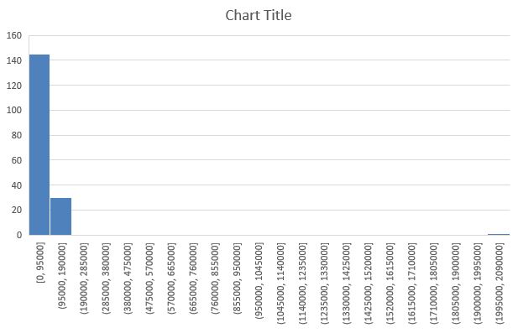
RESULTS
11

Slide 12
conclusion
Pivot table has efficiently streamlined our employee data analysis allowing us to quickly summarize and viPivot tables have effectively streamlined our employee data analysis, allowing us to quickly summarize and visualize key metrics. They have enabled us to identify trends in employee distribution, performance, and retention, enhancing our decision-making and strategic planning. Overall, pivot tables have proven to be a valuable tool for gaining actionable insights and improving HR management.

